Slide 1
Windows Active Directory Domain Services
Cybersecurity
Lesson 7.3

Slide 2

Learning Objectives
By the end of today’s class, you will be able to:
1
Explain how Active Directory is used to manage enterprise-scale environments.
2
Define domain controllers as servers that manage AD authentication and authorization.
3
Use Active Directory tools to create organizational units, users, and groups.
4
Create and link Group Policy Objects that enforce domain-hardening policies.

Slide 4

Recap
PowerShell Scripting
01
Used PowerShell to navigate system directories.
02
Created event logs with pipes and parameters.
03
Created script to remove Windows packages.

Slide 5
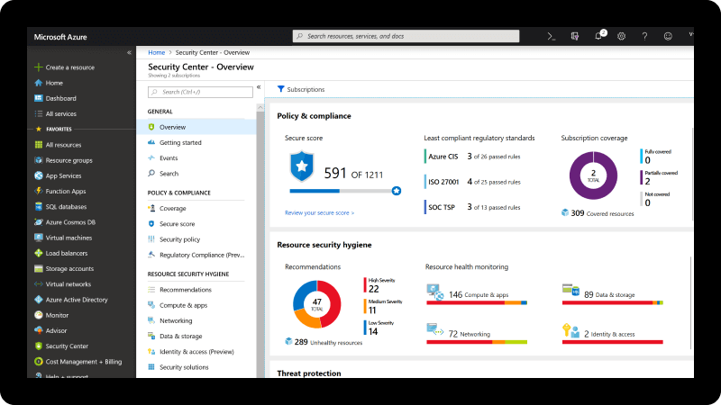
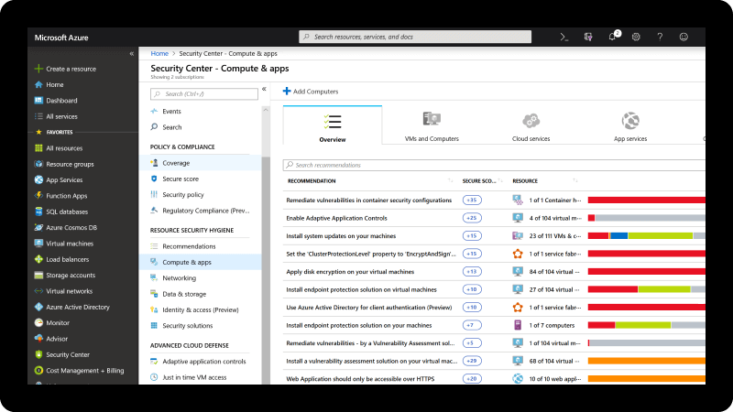
Today, we're going to learn how to manage Active Directory Domain Services.
Active Directory Domain Services or Active Directory (AD)

Slide 6
Active Directory is the central databasing and management system for enterprise-scale Windows environments.

Slide 7

Having a strong understanding of Active Directory is crucial for anyone working in Windows-based system administration and security.
Notes:
shutterstock_1538502431

Slide 8



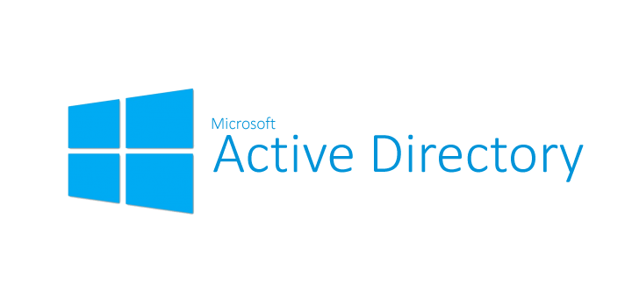
Active Directory
The majority of roles in security fields interact with Active Directory.
Common knowledge and understanding by:
Security analysts
Threat hunters
Forensics experts
Incidence responders
Leverage vulnerabilities and exploits:
Penetration testing
Threat intelligence
Malware reverse engineering

Slide 9

Workgroups & Active Directory

Slide 10
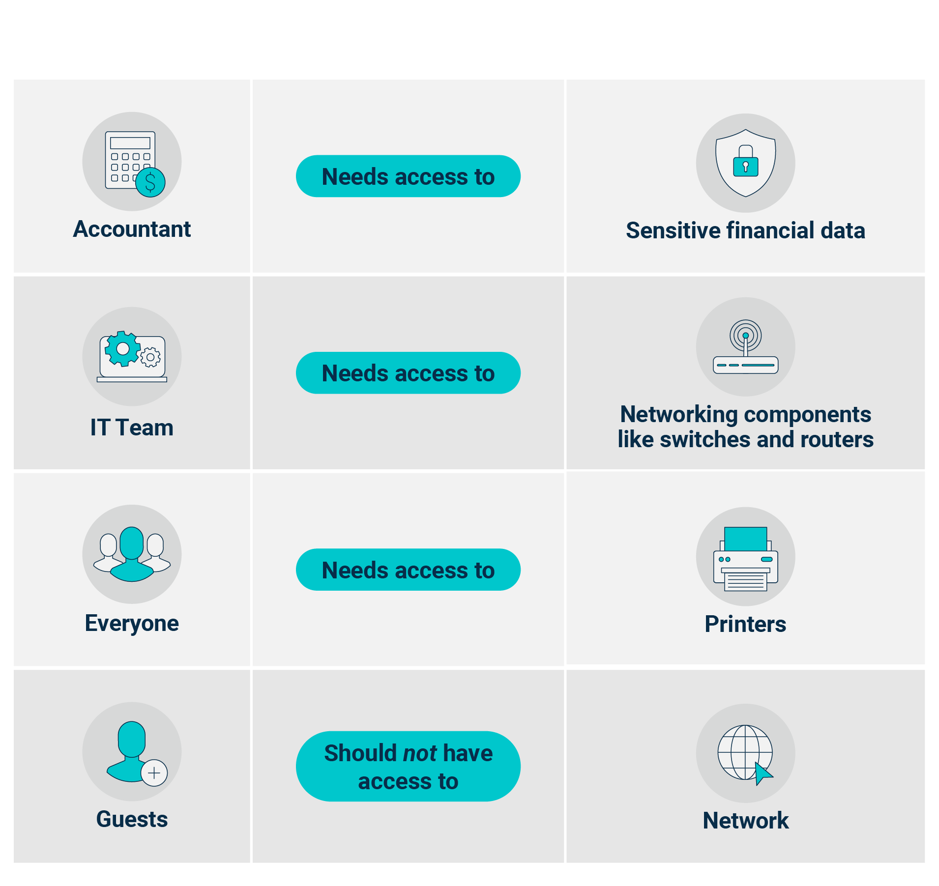
Workgroups & AD
Suppose a small startup with
20 employees receives a large amount of funding and adds 100 more employees to the company.
Everyone shared resources, but now the company needs to restrict access.
Notes:
Avatar: shutterstock_1383859511
Image sources: shutterstock_149136494 (computer, switch, router, printer); shutterstock_400856290 (shield/lock)shutterstock_396885847 (network access icon)

Slide 11
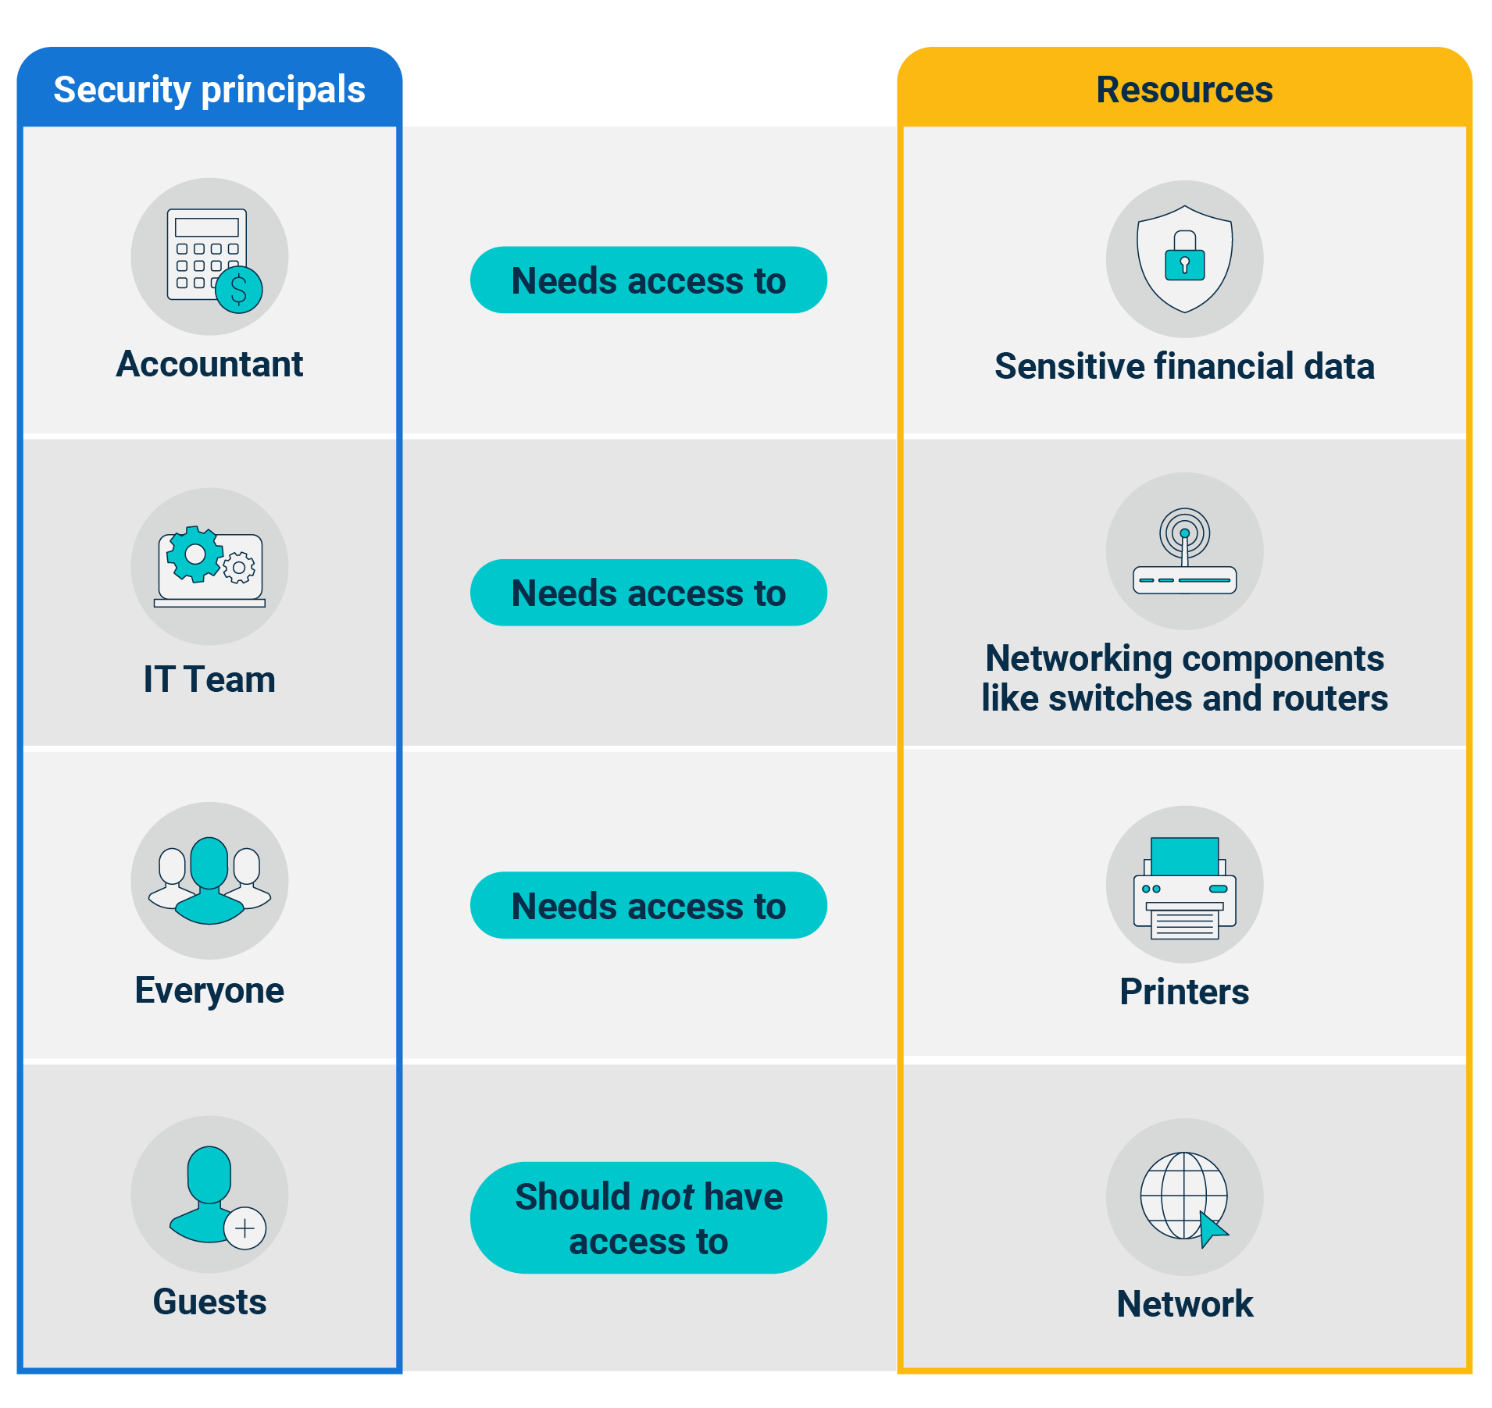
Workgroups & AD
Security principals
are AD objects that can be authenticated, such as users and groups.
Resources are files, networking components, and printers that users need permission to access.
Notes:
Avatar: shutterstock_1383859511
Icons: shutterstock_149136494

Slide 12
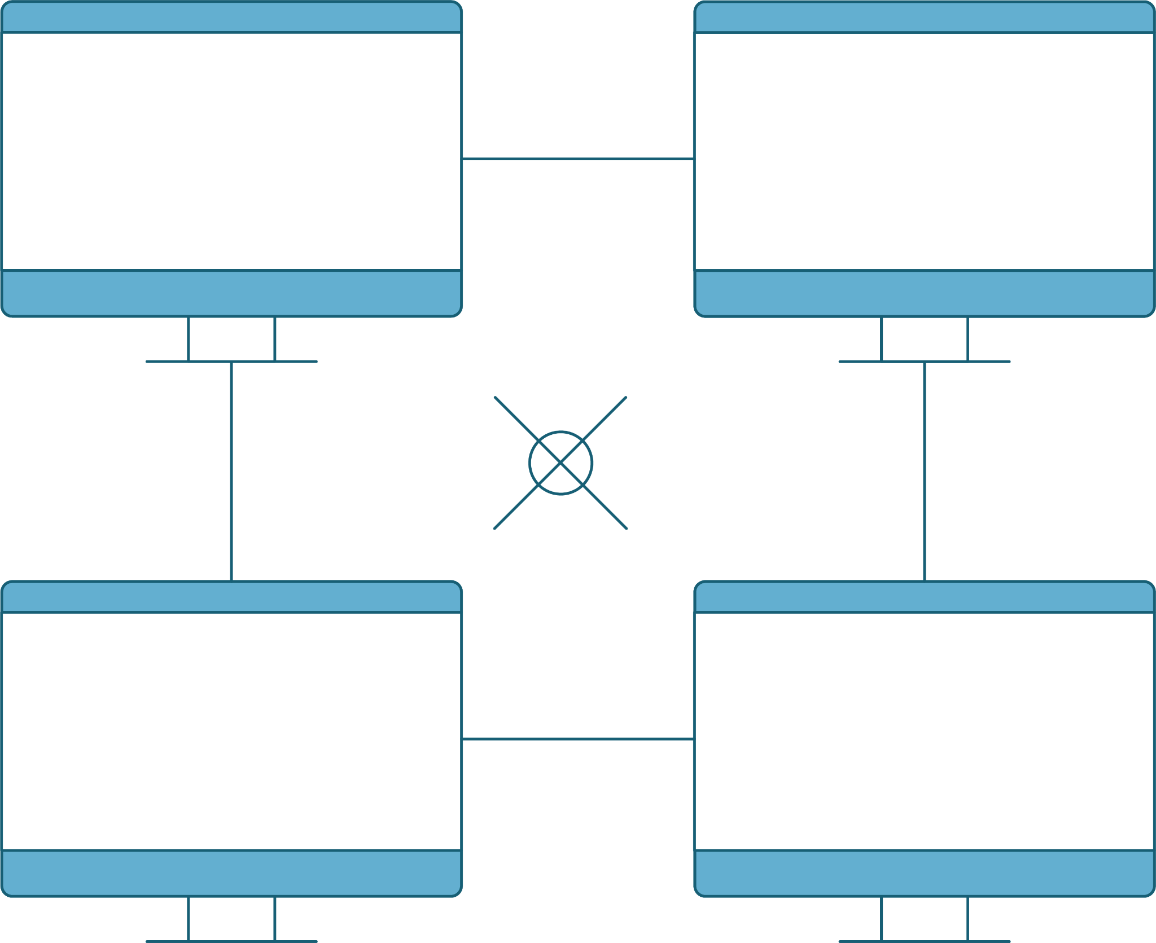
Workgroups & AD
Currently, the company is set up in a Windows Workgroup:
Simple setup
Peer-to-peer
Individual security
Local authentication
Notes:
Avatar: shutterstock_1383859511
Icons: shutterstock_149136494

Slide 13
Active Directory helps us manage these resources and security principals by enforcing authentication and authorization.

Slide 14
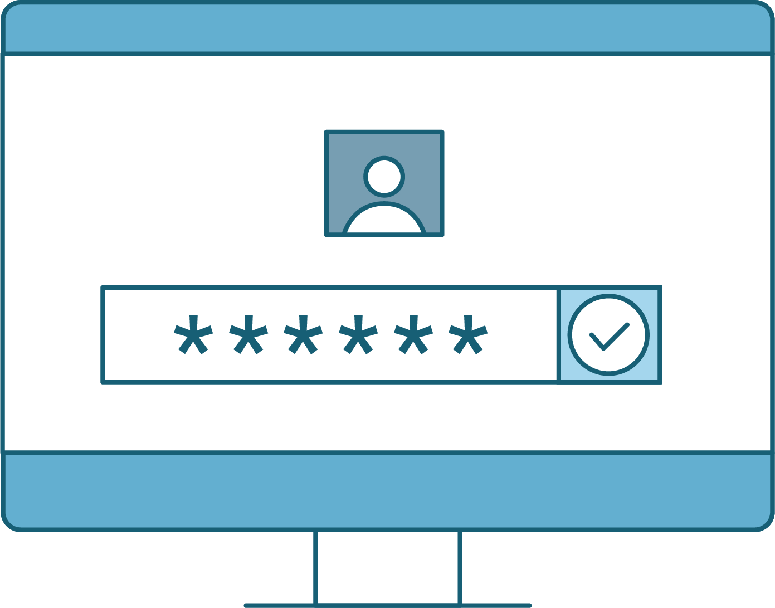
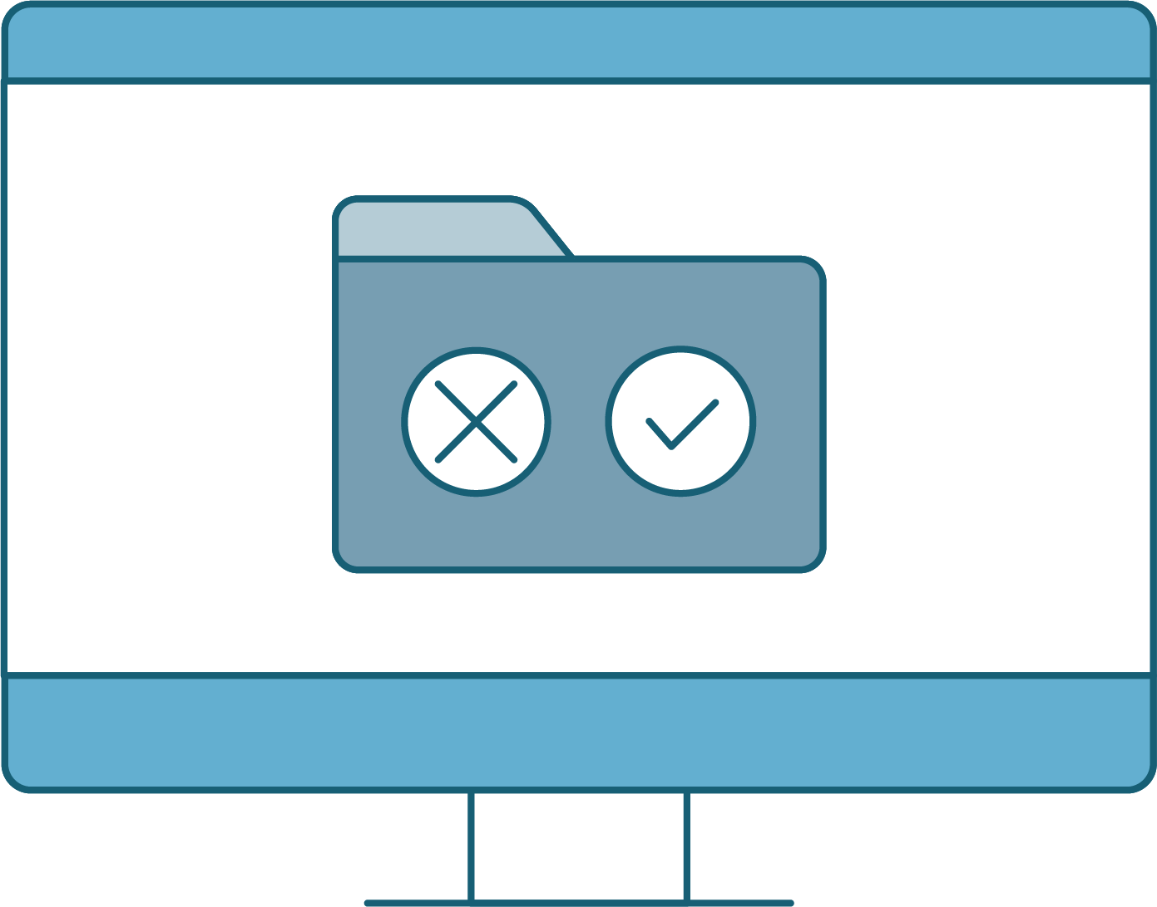


Authentication
Authorization
Allows users to prove their identity using a password, token, or biometric key.
Provides or denies users permission to material.

Slide 15
The principle of least privilege from the Linux sysadmin units?

Slide 16






Active Directory
Also helpful in the following areas:
Compliance
Risk Management
Access Control
Implementing controls, which are crucial for passing security audits.
Can tie directly to business functions, such as finance, and external parties.
ACLs use security identifiers to manage which principals can access which resources.

Slide 17
Active Directory understands an organization’s resources and security principals as objects.

Slide 18
Objects are the users, groups, and computers, as well as the file shares, network printers, and other resources that users need to access.

Slide 19
Before we can understand how AD works, let's discuss what a Windows Server Domain is.

Slide 20
A Windows Server Domain is a digital grouping of all object types, such as the users, computers, network resources, and security principals in an enterprise.

Slide 21

Windows Domains and Domain Controllers
The Domain Controller (DC) is a server that manages access to all the domain resources.
Runs Active Directory
Handles authentication
Verifies database for requests

Slide 22





AD Architecture
Active Directory framework has multiple levels
Containers
Organizational Units
(OU)
Groups
Virtual collections of objects.
Collections of objects that have policies applied to them.
Used to manage identical permissions and access controls for security purposes.
-Distribution Groups
-Security Groups

Slide 23


AD Architecture
Active Directory framework has multiple levels
Containers
Organizational Units
(OU)
Collections of one or more domains and domain trees.
Two or more trees that are part of the same AD configuration.

Slide 24
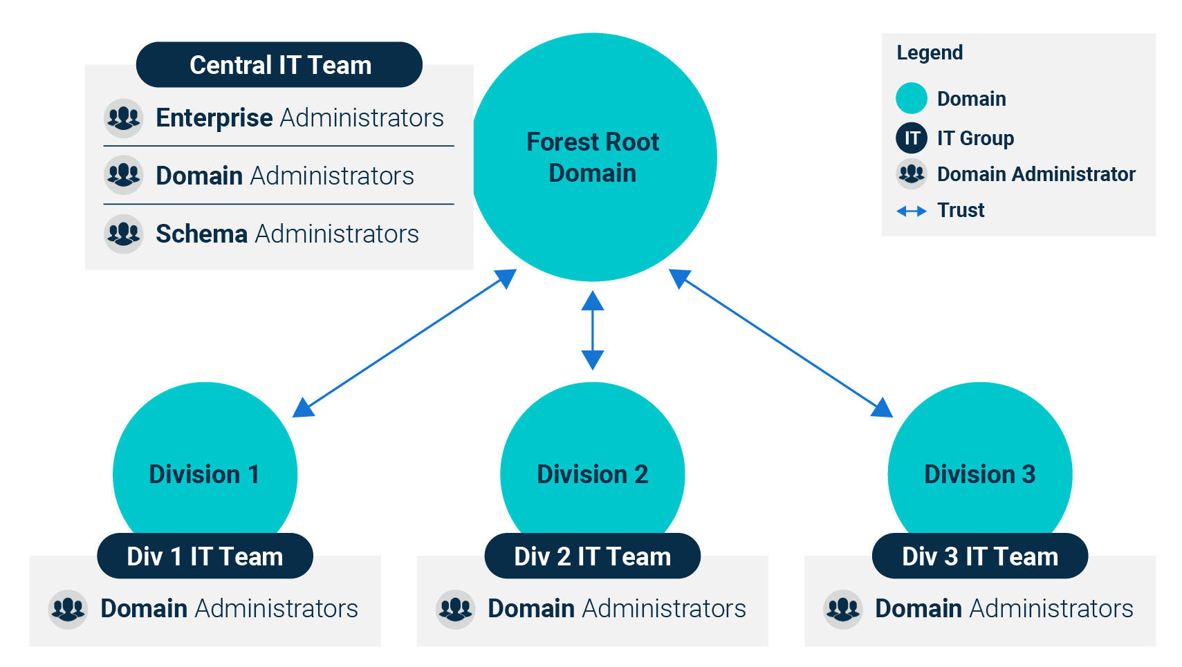
AD Architecture
Active Directory has a hierarchical structure of organizational units, users, machines, groups, domains, trees, and forests.
https://docs.microsoft.com

Slide 25
AD Authentication
AD uses the following authentication protocols:
LDAP
(Lightweight Directory
Access Protocol)
Kerberos
NTLM
(New Technology LAN Manager)
A standardized protocol for adding, deleting, and editing objects.
A ticket-based authentication protocol, now the default authentication protocol for Windows Server domains.
An authentication protocol that has become outdated because of pass-the-hash attacks.
Notes:
Image source: shutterstock_1367319962

Slide 26
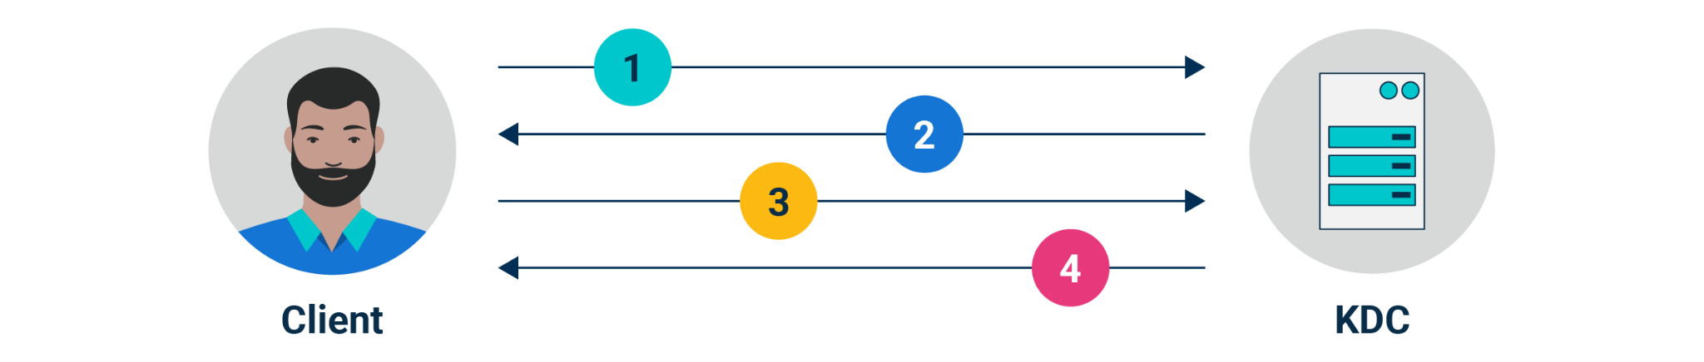
Kerberos Overview
Bob is attempting to access a networked file server:
1
2
3
4
Bob’s Windows 10 machine sends a request to authenticate the Key Distribution Center (KDC), seeking a Ticket-Granting Ticket (TGT).
A KDC has a database of
valid credentials, an Authentication Server, and a Ticket-Granting Server.
Once his credentials are verified, Bob receives a TGT that allows him to request access to resources.
That TGT is cached and permits him to request
more tickets for the current domain session.
When Bob attempts to access the file server, he sends the TGT to the Ticket-Granting Server, requesting access to the file server.
The KDC checks if the file server exists and whether the TGT is valid. If it is, the KDC sends Bob an encrypted service ticket containing info he authenticated earlier, and a session key. Bob is then sent the encrypted service ticket and a copy of the session key.

Slide 27
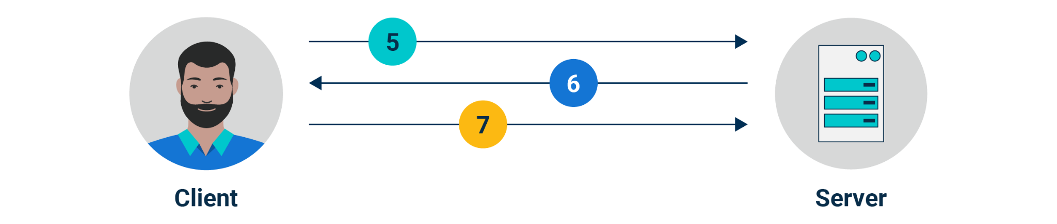
Kerberos Overview
Bob is attempting to access a networked file server:
5
6
7
Bob then uses the session key to encrypt a new message containing his current information and send that, along with the service ticket, to the file server.
The file server then decrypts the service ticket containing the session key, and uses that session key to decrypt the message from Bob that contains his current information.
Finally, the file server uses the session key to encrypt a new message to be sent to Bob containing information about the file server.
If Bob’s existing copy of the session key properly decrypts the message, the file server is verified.

Slide 28

Creating OUs, Users, and Groups

Slide 29


Demonstration Scenario
Creating Organizational Units
We will continue our system administration tasks and set up users in Active Directory so they have accounts that are logically assigned to organization units and groups.
We need to set up marketing associate, Caroline, as a new user in Active Directory.
To do this, we will need to create organizational units (OUs), users,
and groups.
Notes:
shutterstock_1888488028

Slide 30
Creating Organizational Units

Slide 32
Creating Domain OUs, Users, and Groups
In this activity, you are tasked with setting up users, groups, and organizational units for your domain.
In this scenario, your company needs you to set up the domain accounts for the people who will be using the Windows workstations.
You will need to set up two users: Andrew and Bob. Andrew is in the development department and Bob is in the sales department.
20 Minutes

Slide 36

Group Policy Objects

Slide 37
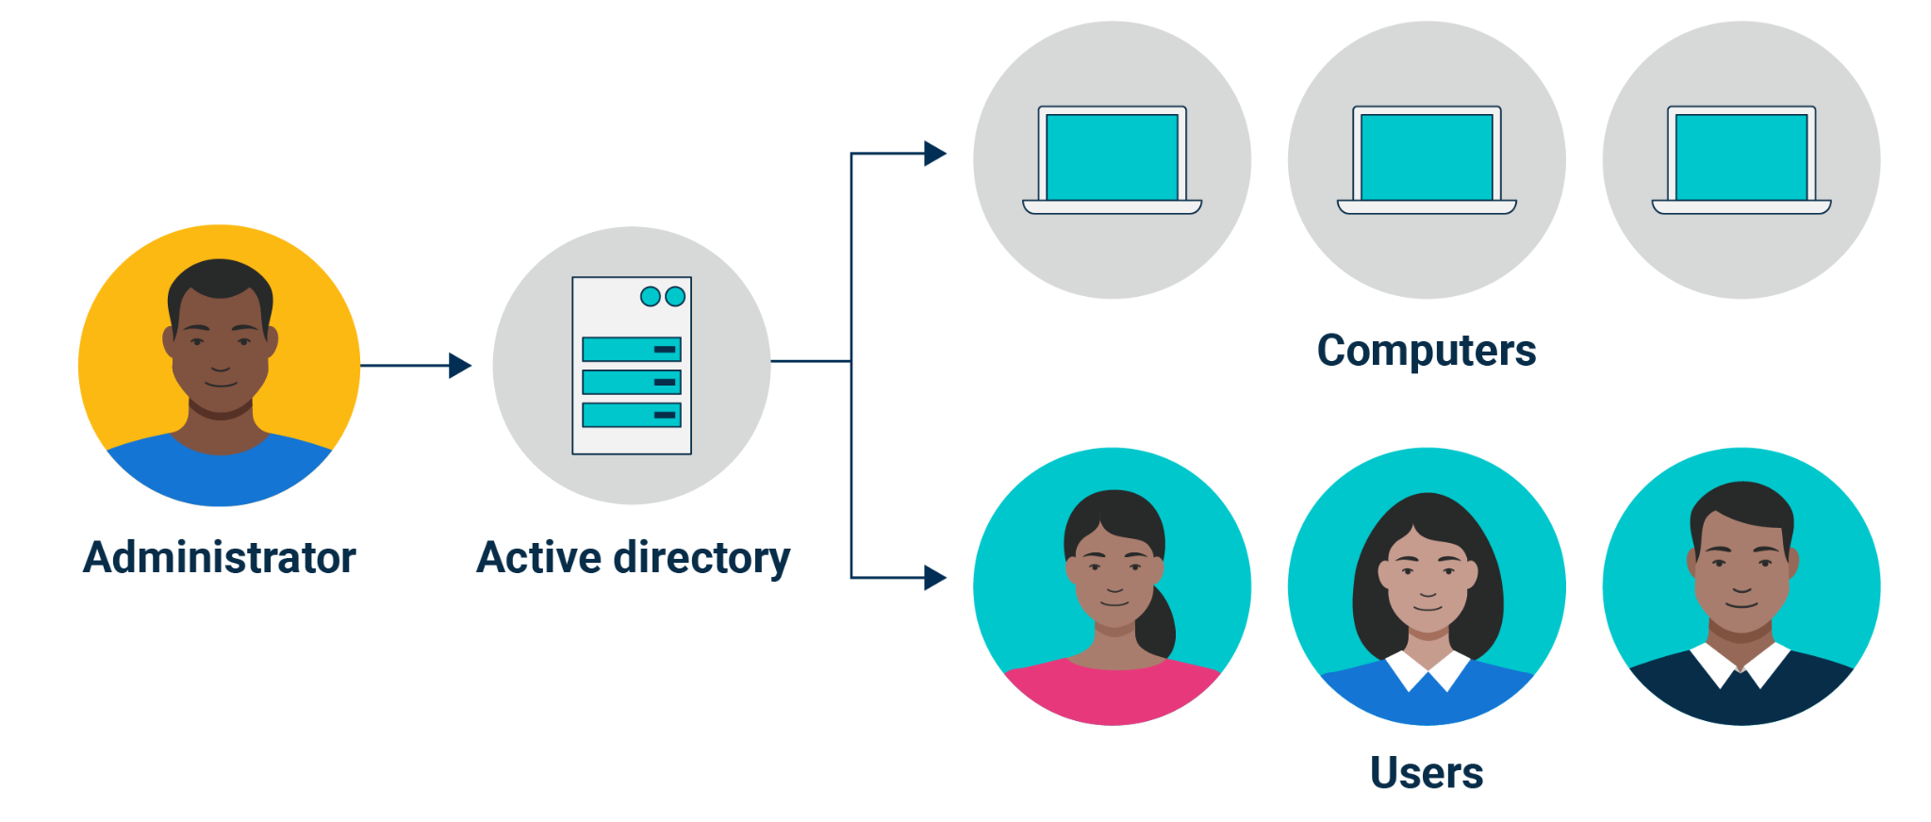
Now that we have OUs, groups, and users, we can create Group Policies that enforce the principle of least privilege.
Computers
Administrator
Active Directory
Users

Slide 38
Group Policy Objects (GPOs) are packages of policy settings that contain one or more group policies.

Slide 39

Group Policy Objects
GPOs are the basis of AD’s policy management. For example, if we want to:
Implement password complexity requirements
for accountants.
Deploy
some form
of anti-malware software when
they next log on.
We can combine these two policies into one GPO called Better Password
and Anti-Malware Setup and apply it to all accountants in the OU.

Slide 40
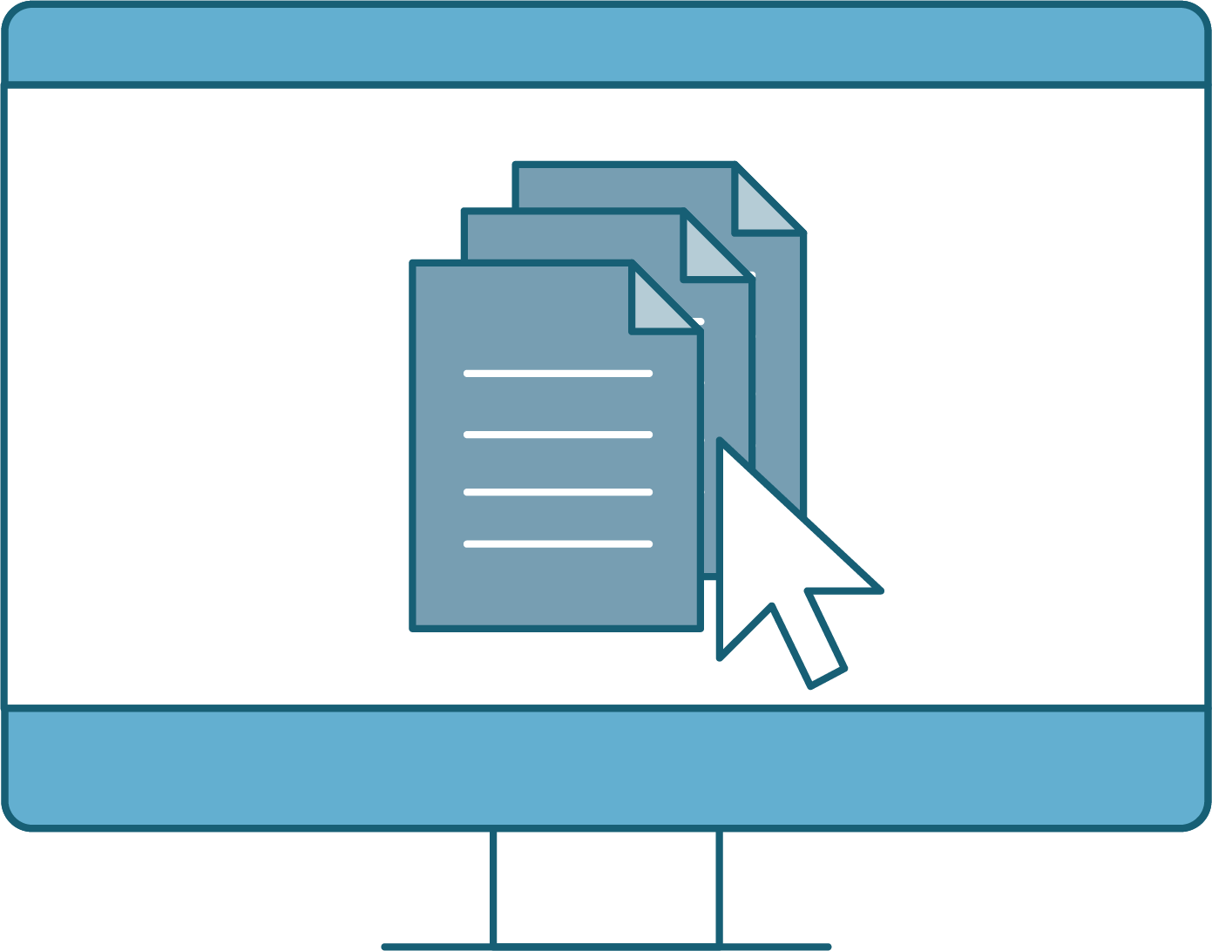
Demonstration Scenario
Creating Group Policy with Group Policy Objects
We want our Sales team to have limited access to Windows Control Panel.
In order to do this, we will need to:
Create a Group Policy Object.
Edit the individual policies for our Group Policy Object.
Link the Group Policy Object to an organizational unit.
Pull the latest Active Directory changes in the Windows 10 machine.
Check if the GPO worked.
Notes:
shutterstock_1888488028

Slide 41
Create New Group Policy Object

Slide 42
Creating Group Policy with Group Policy Objects
For this activity, you are continuing your role as a Windows system administrator managing Active Directory for Good Corp, Inc.
You need to create Group Policy Objects to enforce policies for users.
You are tasked with creating a Group Policy Object for the Sales OU that will limit the options it has in Windows Settings.
25 Minutes

Slide 45


Windows Defender

Slide 46

Windows Defender
Microsoft's built-in anti-malware solution
Windows Defender can work to secure workstations via:
Real-time protection
Scheduled scans
Exclusions
Block at First Sight
Tamper protection

Slide 47






Windows Defender
Key Features
01
02
03
Cloud-delivered protection
Family options
Ransomware protection

Slide 48






Windows Defender
Key Features
04
05
06
Browser integration
Exploit protection
Offline scanning

Slide 49

Defender Policies
Defender itself can have policies.
Policies can ensure that the security measures are uniformly applied across all workstations and servers, and they can tailor the functionality of Windows Defender.
Scan preferences
Signature updates
Exclusions
Firewall settings
Sensitive folder protection

Slide 50

Designing Active Directory infrastructure is a critical task.
There are some best practices to ensure efficiency and security.

Slide 51
AD Best Practices
Fully understand the organizational structure and potential growth
Opt for a simpler design
Design the AD infrastructure to scale with growth
Test all GPOs in a lab or staging environment before deploying
Document the AD structure, policies, permissions, and any changes

Slide 53
Windows Active Directory Certificate Services

